Slide 1
Biology
Unit 7: Genetics and Heredity
Lesson 4: Mutations and Genetic Diversity
Notes:
Lesson Objective:
Explain how mutations can increase genetic diversity.

Slide 2

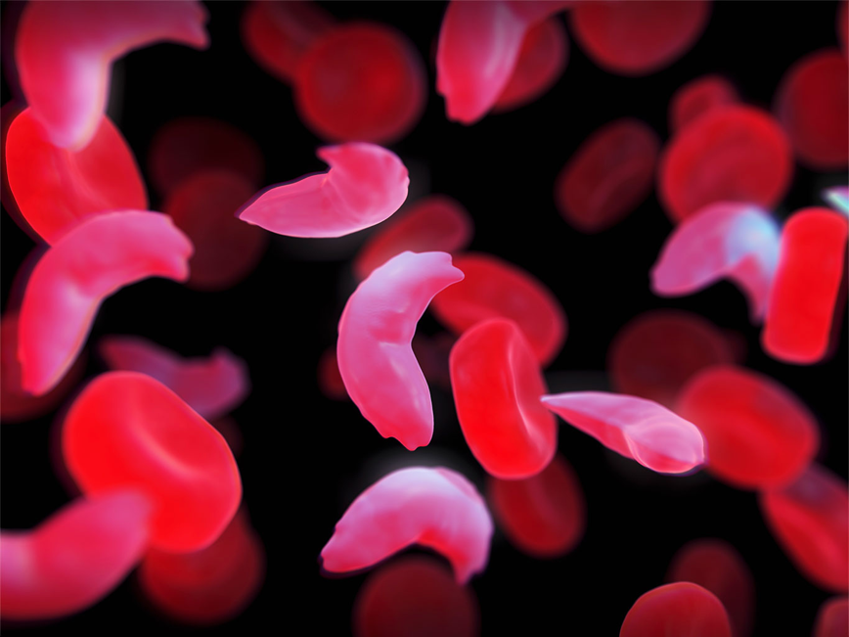
Can You Explain It?
Unit 7 Lesson 4
Why might the HbS allele be more common in some parts of the world than in others? What do you think causes this pattern?
Notes:
Lesson Objective Use models to draw conclusions about the properties of atoms, ions, and molecules and the breaking and forming of bonds between these particles in chemical reactions.

Slide 3
Gene Mutations
Unit 7 Lesson 4
Gene mutations are changes in the DNA sequence of a single gene.
Mutagens are agents in the environment that can change DNA or increase the frequency of mutation in organisms.

Slide 4
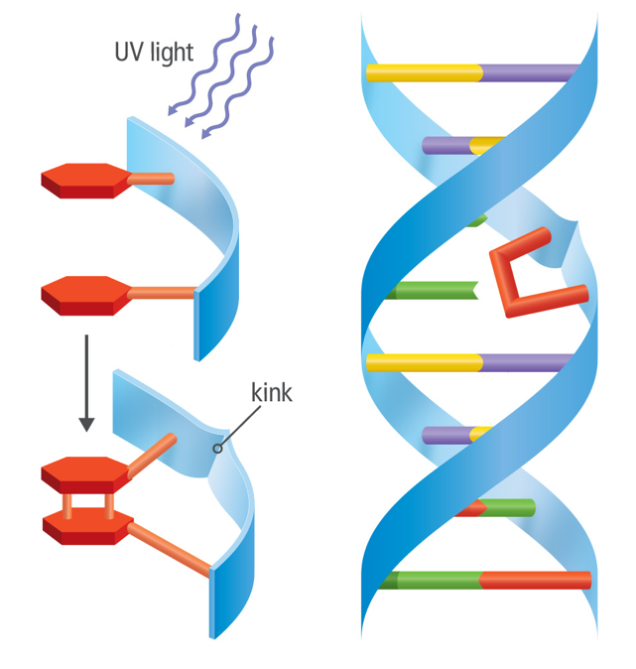
Gene Mutations
Unit 7 Lesson 4
A thymine dimer occurs when UV light causes two thymine bases to bond to one another.

Slide 5
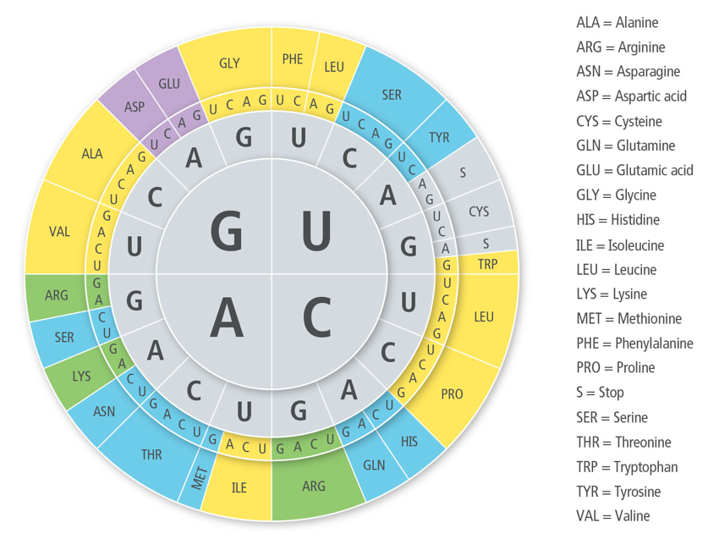
Gene Mutations Cause and Effect
Unit 7 Lesson 4
Which mutations changed the identity of the amino acid as compared to the normal sequence?
If you had to make names for the three types of mutations you analyzed, what would they be?

Slide 6
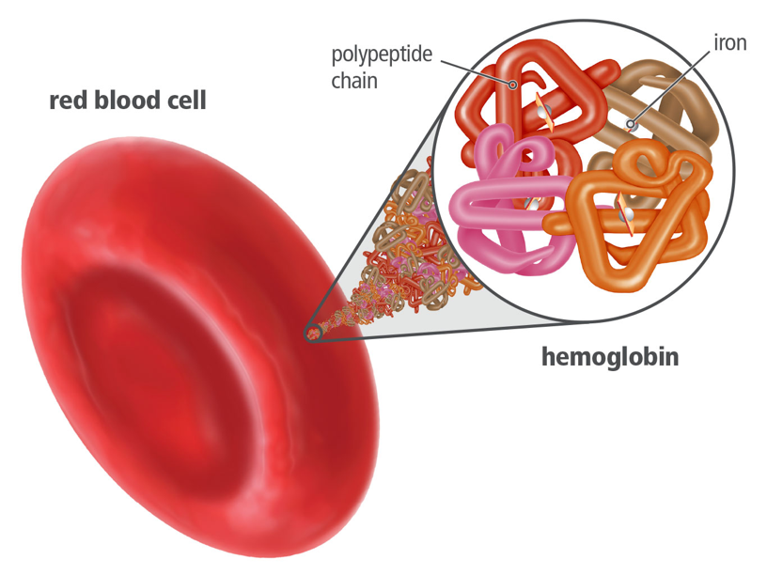
Gene Mutations
Unit 7 Lesson 4
Sickle cell anemia is caused by a point mutation that alters the gene that codes for the hemoglobin protein in red blood cells.

Slide 7
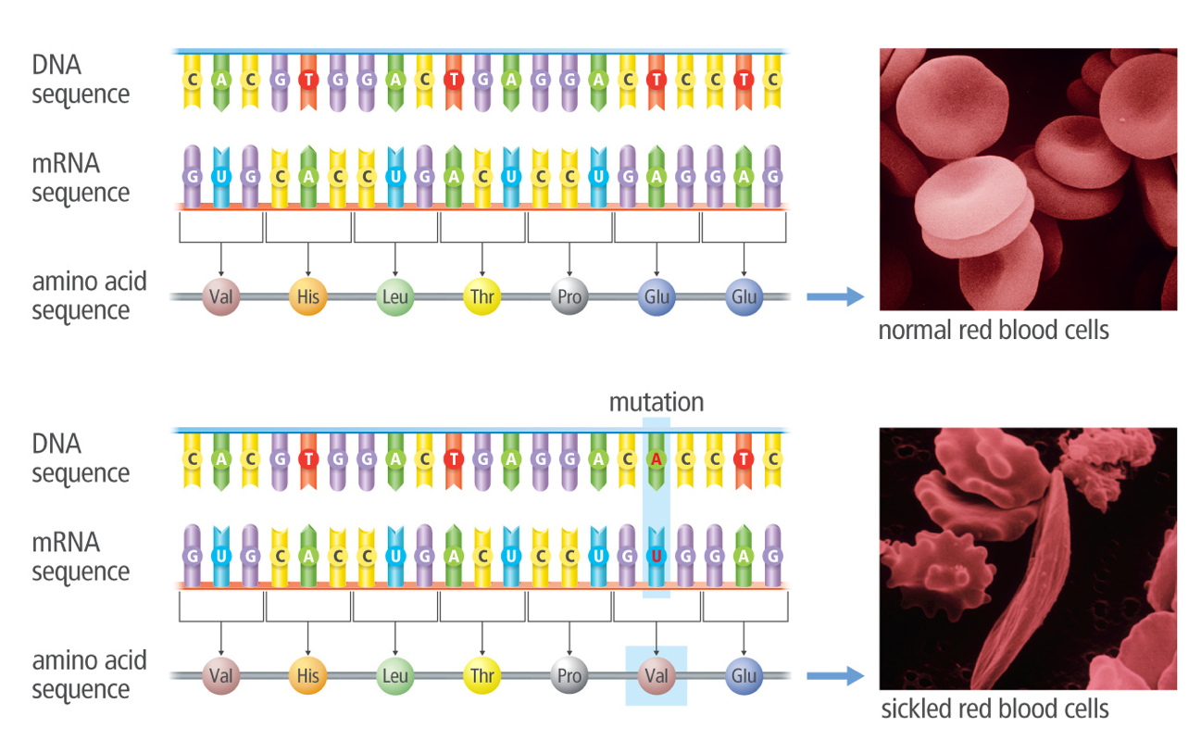
Gene Mutations
Unit 7 Lesson 4
Sickle cell anemia results from a mutation that alters the structure of hemoglobin.

Slide 8
Gene Mutations
Unit 7 Lesson 4
MODEL
Draw a flow chart to illustrate how a change in a nucleotide in a DNA strand leads to symptoms experienced by those with sickle cell anemia.

Slide 9
Gene Mutations
Unit 7 Lesson 4
ANALYZE
People with sickle cell anemia have two copies of the gene. People with one copy are carriers and do not have the disease.
Is the sickle cell allele dominant or recessive? Explain how you know.
If two carriers have children, what is the probability of one of their children having the disease?

Slide 10
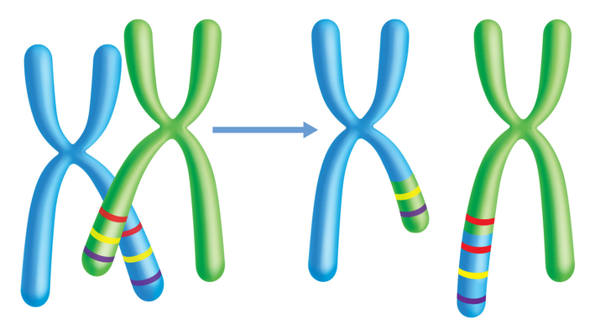
Chromosomal Mutations
Unit 7 Lesson 4
Chromosomal mutations are changes in either chromosome segments or whole chromosomes.
Mutations can have harmful effects, but they can also increase genetic variation, or the variety of traits among individuals within a population.
When homologous chromosomes do not align properly during meiosis, gene duplication can occur.

Slide 11
Chromosomal Mutations
Unit 7 Lesson 4
MODEL
Draw a model illustrating how gene duplication and mutations can lead to a gene with a new function over the course of several generations.

Slide 12
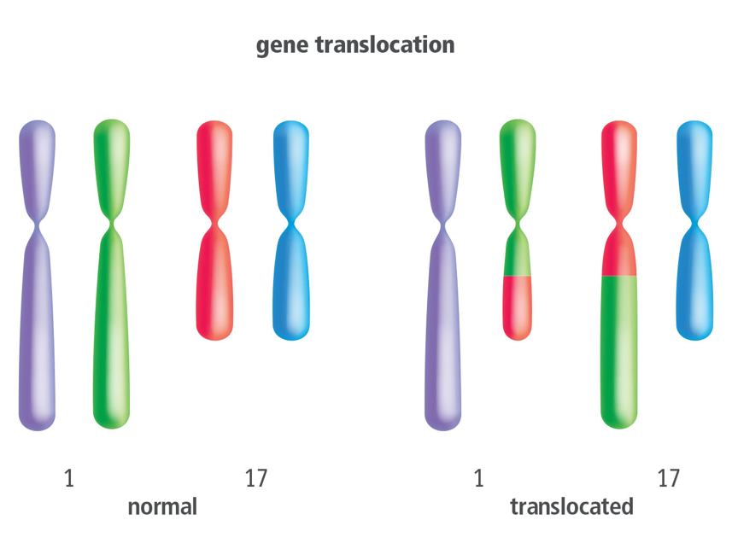
Chromosomal Mutations
Unit 7 Lesson 4
Gene translocation involves the exchange of genetic material between nonhomologous chromosomes.

Slide 13
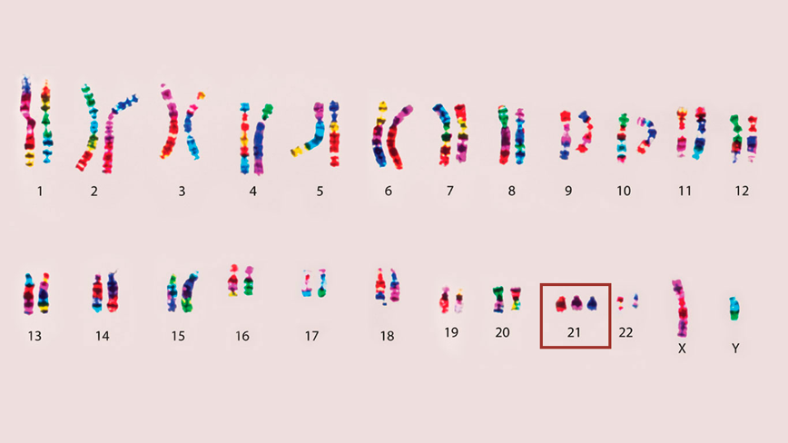
Chromosomal Mutations
Unit 7 Lesson 4
Nondisjunction mutations occur when one or more homologous chromosomes do not separate during anaphase of meiosis.
Draw a model to illustrate how a nondisjunction mutation could occur during either anaphase I or anaphase II of meiosis.

Slide 14
Chromosomal Mutations
Unit 7 Lesson 4
EXPLAIN
Make a chart to organize and describe the main types of mutations you have learned about so far. Then use your chart to help you write an explanation for these questions: When is a mutation likely to increase genetic variation? When is a mutation likely to have harmful effects?

Slide 15
Effects of Mutations
Unit 7 Lesson 4
There are two major types of cells in the body: body cells and germ cells. Germ cells are involved in the formation of gametes.
Body cells, or somatic cells, include all other cells of the body. Mutations happen in both of these cell types, but only mutations in germ cells may be passed from parent to offspring.

Slide 16
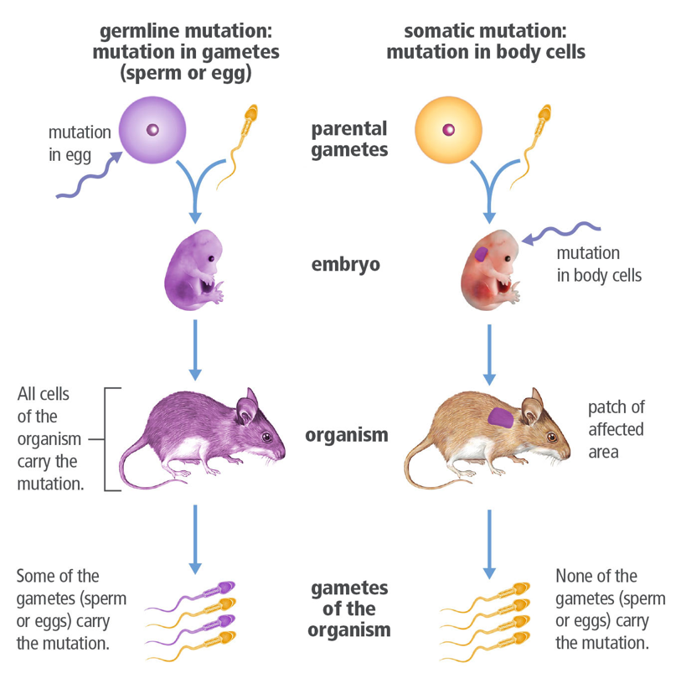
Effects of Mutations
Unit 7 Lesson 4
Mutations can occur in gametes and in body cells.

Slide 17
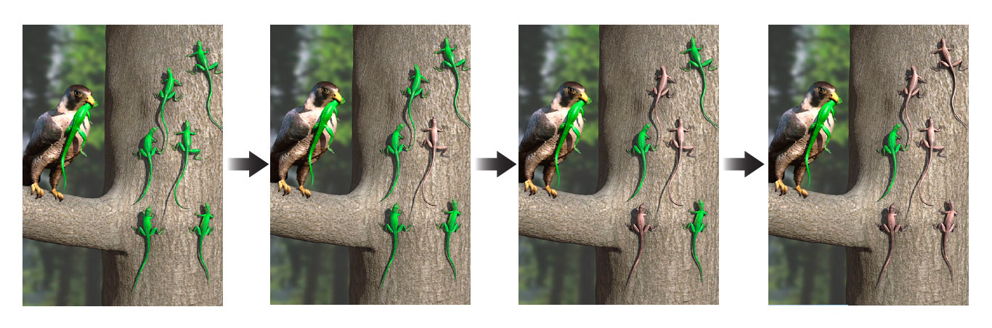
Effects of Mutations
Unit 7 Lesson 4
Genetic variation, or genetic diversity, is the variety of genes within a population.
Genetic diversity is the basis of a process called natural selection. In natural selection, environmental factors “select for” phenotypes that allow organisms to better survive and reproduce.

Slide 18
Effects of Mutations
Unit 7 Lesson 4
EXPLAIN
In some cases, mutations that have some harmful effects continue to persist in certain human populations. Why might a mutation with detrimental effects persist in a given population?

Slide 19
Unit 7 Lesson 4
Continue Your Exploration
Choose one of the paths below to continue your exploration:
Testing UV-Protective Fabrics
Mutations and Human Health
p53: The Tumor Suppressor Gene
Investigating Melanism

Slide 20
Can You Explain It?
Unit 7 Lesson 4
Why is the HbS allele more common in some populations than in others? Answer the following questions in your explanation.
How do changes in DNA lead to changes in the structure of red blood cells in people with the HbS allele?
Is the phenotype that corresponds to the HbS allele harmful, beneficial, or both? Explain your answer.
Why is the frequency of the HbS allele higher in areas near Earth's equator, such as parts of Africa and the Mediterranean?

Slide 21
Image Credits
Unit 7 Lesson 4
karyotype ©L. Willatt/East Anglian Regional Genetics Service/Science Source; blood cells ©Science Picture Co./Getty Images

